Slide 1
Chapters 7/8/9
Unemployment / Inflation / Policy Preview

Slide 2
Introduction
Unemployment and output are tightly linked – but the link is not perfect
Unemployment is a lagging economic indicator
Can be a mistaken guide to policy
Costs of unemployment not equally distributed
Inflation and Indexation

Slide 3
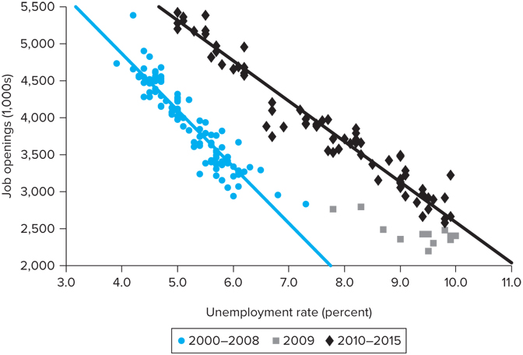
The Beveridge Curve
Finding a job takes time
Job matching process illustrated by the Beveridge Curve which shows unemployment rate vs. number of job openings
During Great Recession and years following unemployment high, but job vacancies higher in period following recession

Slide 4
The Anatomy of Unemployment
Five key characteristics of unemployment in the U.S.:
There are large variations in unemployment rates across groups defined by age, race, or experience.
There is high turnover in the labor market.
A significant part of this turnover is cyclical: Layoffs and separations are high during recessions, and voluntary quits are high during booms.
Most people who become unemployed in any given month remain unemployed for only a short time.
Much of the U.S. unemployment consists of people who will be unemployed for quite a long time.

Slide 5
The Anatomy of Unemployment
The size of the labor force (unemployed (U) + employed (E))is determined from surveys by the BLS
Unemployed is one who is out of work and who either
Has actively looked for work during the previous 4 weeks OR
Is waiting to be recalled to a job after having been laid off
Employed person is one who during the reference week:
Did at least one hour of work for pay in the last week
Worked at least 15 hours as an unpaid worker for an enterprise owned by a family member OR
Was not working, but only temporarily absent from work (ex. vacation or maternity leave)
Notes:
Source: Bureau of Labor Statistics.

Slide 6
The Unemployment Pool
At any point in time there is a given number (pool) of unemployed people
There are flows in and out of the unemployment pool Which could be due to new entrant or reentrant into the LF, losing job, being recalled, stop looking for a job, etc.
Table 7-1: U.S. Labor Force and Unemployment, 2015 (Millions of Persons 16 Years and Over)
Working-age population | 250.8
Labor force | 157.1
Employed | 148.8
Unemployed | 8.3
Not in labor force | 93.7
Source: Bureau of Labor Statistics

Slide 7
Variation in Unemployment Across Groups
The aggregate unemployment rate tells us the share of the labor force that is unemployed
The aggregate number conceals wide variations across various segments of the population
The relationship between the aggregate unemployment rate, u, and that of groups is:
(1)
w_{i} are the fraction of the civilian LF that falls within a specific group

Slide 8
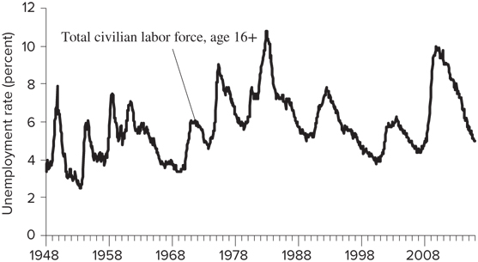
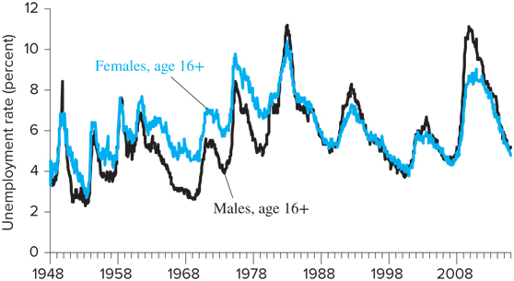
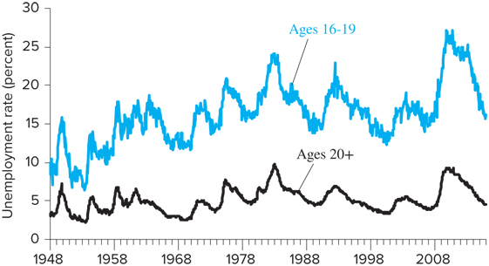
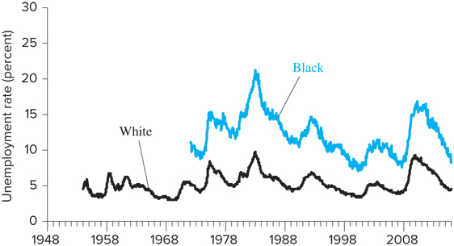
Variation in Unemployment Across Groups

Slide 9
Duration of Unemployment
Another issue to consider when examining unemployment is the duration of unemployment spells
A spell of unemployment is a period in which an individual remains continuously unemployed
The duration of unemployment is the average length of time a person remains unemployed

Slide 10
Unemployment by Duration
Length of Unemployment, Weeks | Percent of Unemployed
 | 2006 | 2009 | 2015
Less than 5 | 37.3 | 22.2 | 28.9
5-14 | 30.3 | 26.8 | 27.7
15-26 | 14.7 | 19.5 | 15.3
27-51 | 7.6 | 15.2 | 9.4
52 and over | 10.0 | 16.3 | 18.6
Mean number of weeks | 16.8 wk. | 24.4 wk. | 29.2 wk.
Median number of weeks | 8.3 wk. | 15.1 wk. | 11.6 wk.
Unemployment rate | 4.6 | 9.3 | 5.3
Source: Bureau of Labor Statistics

Slide 11
Determinants of the Natural Rate
The determinants of the natural rate of unemployment, u*, can be thought of in terms of the duration and frequency of unemployment
The duration of unemployment depends on cyclical factors and on the following structural characteristics of the labor market:
The organization of the labor market, including the presence or absence of employment agencies, youth employment services, etc.
The demographic makeup of the labor force
The ability and desire of the unemployed to keep looking for a better job, which depends in part on the availability of unemployment benefits

Slide 12
Determinants of the Natural Rate
The frequency of unemployment is the average number of times per period that workers become unemployed
Two basic determinants of the frequency of unemployment:
Variability of the demand for labor across different firms in the economy
The rate at which new workers enter the labor force, since new potential workers begin as unemployed workers

Slide 13
Estimates of the Natural Rate
The equation for the natural rate of unemployment is similar to equation (1): (2)
Equation (2) says that the natural rate is the weighted average of the natural rates of unemployment of the subgroups in the LF
Several adjustments are needed to account for:
Changing composition of the LF, including increasing share of teenagers
Changes in the fundamental determinants of the natural rate, including unemployment benefits

Slide 14
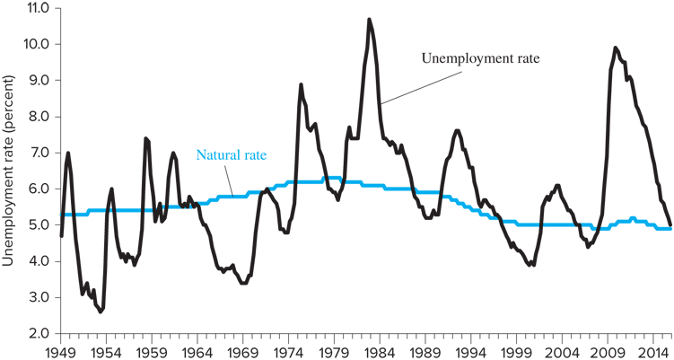
Estimates of the Natural Rate
The Congressional Budget Office (CBO) provides an official full-employment-unemployment rate estimate
If actual unemployment rate is above natural rate, u > u* and Y < Y*
If actual unemployment rate is below natural rate, u < u* and Y > Y*

Slide 15
Hysteresis and the Rising Natural Rate of Unemployment
Between 1973 and 1988 the U.S. unemployment rate stayed well above the natural rate estimated using the demographic adjustment method
Some economists argue that the unemployment rate over long periods cannot move too far from the natural rate → the natural rate must have increased over this time period
WHY?

Slide 16
Hysteresis and the Rising Natural Rate of Unemployment
Unemployment hysteresis: extended periods of high unemployment raise the natural rate
Unemployed might become accustomed to not working
Unemployed could become discouraged and not vigorously seek work
Long unemployment spells might signal to firms that a worker is undesirable, and the firms might avoid hiring such workers

Slide 17
Unemployment Benefits
Unemployment benefits increase the rate of unemployment in two ways:
Unemployment benefits allow for longer job searches
Lessens the severity of being in and out of jobs
Unemployment benefits increase the measured unemployment rate through reporting effects
One estimate suggests that reporting effects raise the unemployment rate by about half a percentage point

Slide 18
Inflation
Perfectly anticipated inflation: Suppose an economy has been experiencing inflation of 5% and the anticipated rate of inflation is also 5%, then all contracts will build in the expected 5% inflation
Imperfectly anticipated inflation: full adjustment to inflation does not describe economies in the real world → imperfectly anticipated
Inefficient Decision Making: The possibility of unexpected inflation introduces an element of risk, which might prevent some from making some exchanges they otherwise would undertake
Redistribution of wealth between debtors and creditors

Slide 19
Inflation and Indexation
In counties where inflation rates are high and uncertain, long-term borrowing using nominal debt becomes impossible: lenders are simply too uncertain about the real value of the repayments they will receive
In such countries governments issue indexed debt: a bond is indexed to the price level when either the interest rate or the principle or both are adjusted for inflation
Some formal labor contracts include cost of living adjustment (COLA) provisions
Link increases in money wages to increases in the price level

Slide 20
Inflation and Indexation
Suppose real material prices increase, and firms pass these cost increases on as higher prices of final goods
Under a system of wage indexation, wages will also rise → this leads to further price, materials-cost, and wage increases
Indexation in this example feeds an inflation spiral
Need to differentiate between supply and demand shocks to understand the consequences of wage indexation
In the case of a demand shock, there is a “pure” inflation disturbance and firms can afford to pay the same real wages and will not be affected by indexation
→ Wage indexation complicates the adjustment of an economy to supply shocks

Slide 21
Inflation and Indexation
Many have argued that the government should adopt indexation on a broad scale, including bonds and the tax system because:
Inflation would be easier to live with
Costs of unanticipated inflation would disappear
Governments have been reluctant to index for three reasons:
Indexing makes it harder for the economy to adjust to shocks
Indexing adds another layer of calculation to most contracts
Indexation will weaken the political will to fight inflation, lead to higher inflation, and perhaps make the economy worse off

